Slide 1


The unhealthy state of homelessness 2022
Findings
Notes:
Going to take you through the findings from our new report

Slide 2
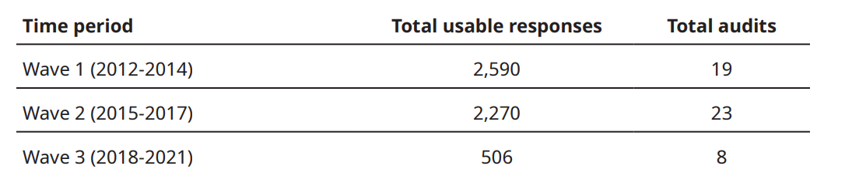
The Unhealthy State of Homelessness 2022
Overview
Builds on findings from 2014 report 'The Unhealthy state of Homelessness’
Presents findings from:
31 new Homeless Health Needs Audits (HHNAs), representing 2,776 individuals.
19 HHNAs undertaken 2012-14, representing 2,590 individuals
Data is presented in three waves:
Notes:
Three waves:
enables us to explore how health inequalities have changed in the ALMOST decade between 2012 and 2021. ​
Will refer to most recent wave of data throughout, unless flag otherwise
NOTE ON DATA
- Unfortunate in wave 3: paused HHNA while we refreshed and consultation AND THEN COVID-19

Slide 3
The Homeless Health Needs Audit (HHNA)
A survey and methodology used by local areas to gather data about the health inequalities faced by people experiencing homelessness in their area.
Asks people currently experiencing homelessness about their health, access to healthcare services and their view of the healthcare they have received.
Survey is administered by local homelessness service providers, including day centres, supported accommodation providers, outreach teams.
Locally it enables commissioning decisions to be driven by evidence of local need
Nationally it provides the only dataset of its kind on the health of people experiencing homelessness
Notes:
DATA COLLECTION TOOL
Whole range of services will be collecting data in order to ensure best representation of people experiencing homelessness in their area
Aggregated it provides the only national dataset of its kind of the health needs and access to services of people experiencing homelessness.
THIS WHAT OUR DATA IS DRAWN FROM

Slide 4





Background
What the HHNA covers
Physical health
Mental health
Substance use
Access to services
Wellbeing and preventative healthcare
Notes:
AUDIT BROKEN INTO THESE KEY AREAS

Slide 5
Background
Overview of respondents
Age
14% - 18-24
69% - 25-54
16% - 55-74
0% - 75+
Gender
68% - Male
30% - Female
1% - Transgender
1% - Non-binary
Immigration status
92% - UK Nationals
5% - EEA Nationals
2% - Permanent residence/ indefinite leave to remain
1% - Other
Notes:
A brief breakdown of our sample:
AGE:
Most of our respondents are 25-54
TREND:
More older people in wave 3 compared to wave 2
IF WE LOOK AT THE STATUORY DATA :
We have more older people (25-54 AND 55-74) than the statutory data (2020/21)
May be sampling – fewer youth specific services
May be that the ‘static’ homeless population are older (i.e. those who have experienced homelessness for some time and not captured in the quarterly stats)
Gender:
WE ASK BECAUSE Highly relevant to the ways in which people experience homelessness
WHEN COMPARE TO STAT DATA
Our data is pretty close to the stat data – we have slightly more men and fewer women (2020/21 single people approaching LA)
66% male
33% female
1% ‘other’
Immigration status:
Captured because
non-UK Nationals more vulnerable to homelessness. Even more so for people with restricted/ undetermined eligibility
Restricted access to some healthcare services
What’s relevant here changed during the data collection period as we left European Union.
In future hope to be able to breakdown and understand more about how imm status affects health and access to healthcare

Slide 6
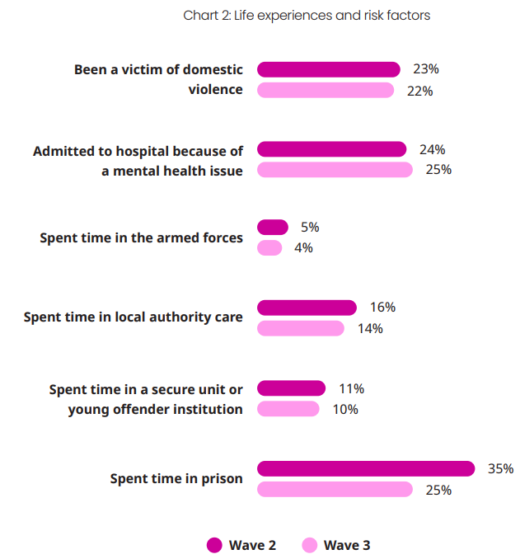
Background
Overview of respondents
Notes:
When we look at the life experience of respondents
- 66% have experienced at least one life experience that we know are associated with higher risk of homelessness
31% have experienced more than one
Highights how interrelated many of these issues are

Slide 7
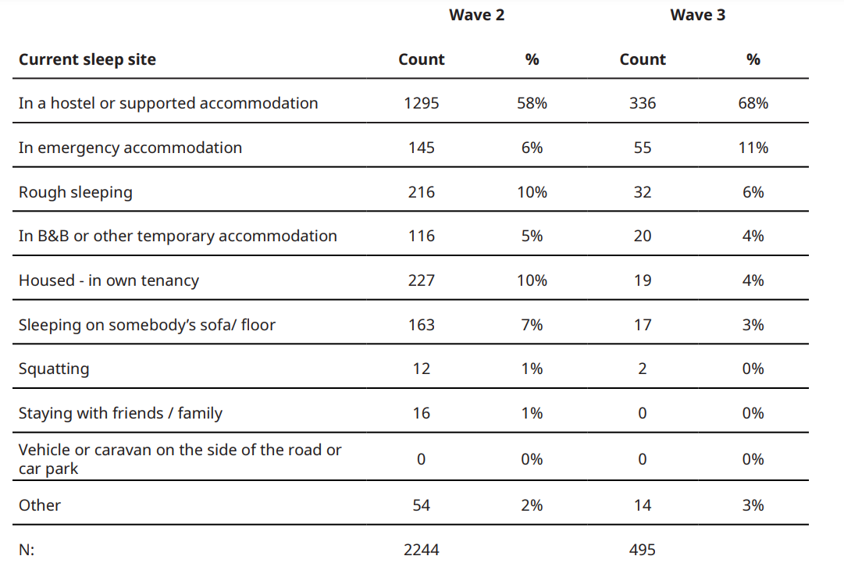
Background
Overview of respondents
Notes:
THIS SLIDE TELLS US WHERE PEOPLE WERE CURRENTLY SLEEPING
Wave 3:
MAJORITY - 68% sleeping in a hostel/ supported accommodation service
11% were sleeping in an emergency accommodation service
6% were currently rough sleeping
CHANGE BETWEEN WAVES 2 and 3 – poss affected by COVID-19
Emergency accommodation increase – possibly due to Everyone In
Fewer people rough sleeping
Fewer people sofa surfing – as people changed their living arrangements

Slide 8
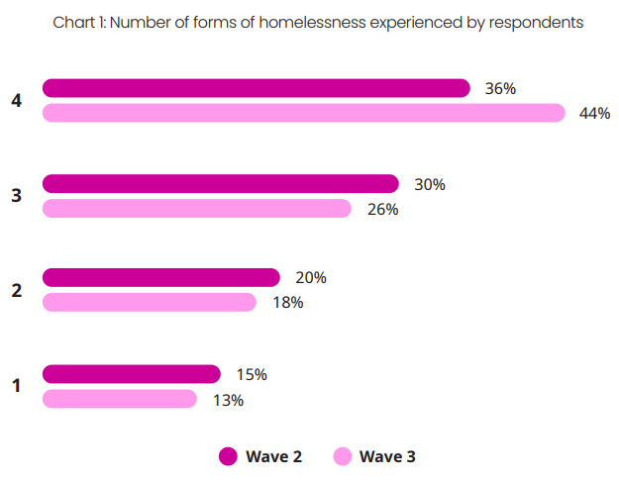
Background
Overview of respondents
Notes:
EVER EXPERIENCED 4 types of homelessness:
Rough sleeping
Sofa surfing
Stayed at a Hostel/ supported accommodation service
Applied to the council as homeless
87% of people have experienced more than one form of homelessness.
44% have experienced all 4
SO Respondents were unlikely to be new to experiencing homelessness

Slide 9



What we found
Physical health
Mental health
Substance use
Wellbeing and preventative healthcare
Access to primary healthcare
Access to acute healthcare
Notes:
Getting into the findings –
Will go through the following

Slide 10

Physical health
Key findings
People experiencing homelessness are much more likely to have a long-term illness or disability than the general population
  63% of HHNA respondents, compared to 22% of the general population.
78% of people report having a physical health condition
80% of respondents with a physical health condition manage comorbidities, with 29% of respondents reporting between 5-10 physical health diagnoses
Notes:
Long term illness/ disability
Much more likely
National data: Family Resources Survey: Financial year 2020 to 21
Physical health
TREND:
Gradual increase in no. of people with a physical health condition:
Up from 73% in wave 1
76% in wave 2
Comorbitidies
Lots of complexity in managing those conditions

Slide 11
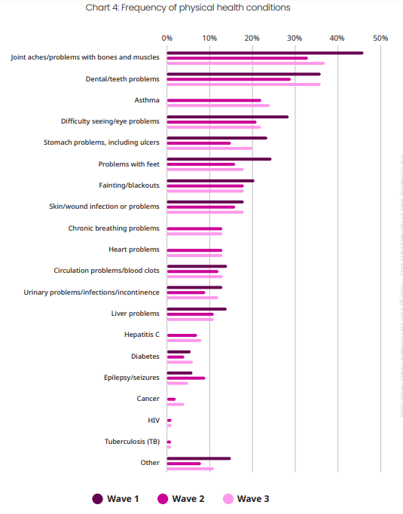
Physical health
Key findings
Notes:
Can see breakdown of the health conditions that people report
General trend
Decrease between waves 1 and 2
- Increase between waves 2 and 3
MOST COMMON CONDITIONS HOLD CONSTANT
joint aches/ problems with bones and muscles – 37% in wave 3.
other research tells us that this can be a direct consequence of the experience of homelessness – GROUNDSWELL ‘Out of Pain’
SECOND MOST COMMON
dental/ teeth problems– at 36% in wave 3.
Up 7% points from wave 2

Slide 12
Physical health
Health management – barriers and consequences
40% of respondents reported that the level of support they received did not meet their needs (39% in wave 2).
  29% of respondents were currently receiving some support, but were in need of more
  11% of respondents reported that they did not receive any support, but that it would help them
27% of respondents told us that they had not received a medical examination or treatment for a physical health condition when it was needed at some point within the last 12 months.
Notes:
When we asked people about the care that they received:
- Lots of people not getting the care that they feel that they need
Can see some gaps in healthcare for people experience homelessness.
This is a theme that we’ll come back to!

Slide 13
Mental health
Key findings
The number of respondents with a mental health diagnosis has increased dramatically since wave 1 – from 45% to 82% in wave 3.
  70 percentage point difference between this population and general population (12%)
81% of people with a mental health condition manage comorbidities
  27% 2 MH conditions
  24% 3 MH conditions
Notes:
TRENDS:
Wave 1 = 45%
Wave 3 = 82%
National data from: GP Patient Survey 2022
The complexity, both for individuals and the services that support them, of supporting people with complex mental health conditions is important to note

Slide 14
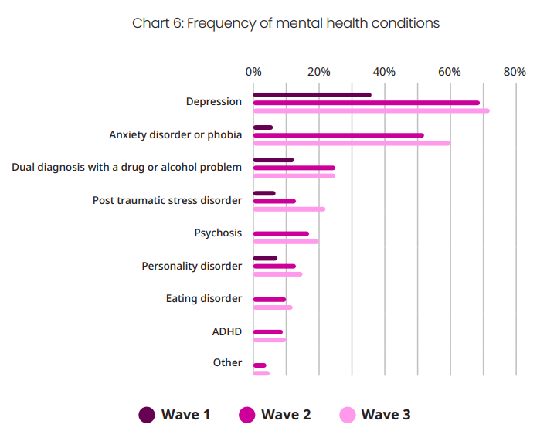
Mental health
Key findings
Notes:
When we break it down, this data looks just as stark
TREND
See a shaper rise between wave 1 and 2 than between 2 and 3 where data is available
Much bigger increases than we see in physical health
54% per point increase in reported anxiety between waves 1 and 3.
36% per point increase in reported depression between waves 1 and 3
72% of respondents reported having depression
60% anxiety disorder or phobia
WANTED TO PICK OUT:
Dual diagnosis – 25%
WHICH IS A MENTAL HEALTH PROBLEM ALONGSIDE DRUG OR ALCOHOL USE
For people with dual diagnosis it can be extremely challenging to access support, as they can be refused access to mental health services until they have ‘dealt with’ their substance use; and refused access to substance use services because of mental ill health.

Slide 15
Mental health
Health management – barriers and consequences
49% of respondents wanted more support that they received (wave 2: 46%)
  31% of respondents told us that they currently accessed mental health support/ treatment, but were in need of more
  18% of respondents reported that they currently received no mental health support, but that it would help them
37% of people responded that there had been at least one time in the past 12 months that they needed an assessment or treatment for a mental health condition but did not receive it. (27% for physical health)
In our Annual Review 2021 just 10% of accommodation providers reporting no trouble accessing mental health services for their clients
Notes:
When we asked people about the care that they received:
THIS CHIMES WITH OTHER DATA
- In our ANNUAL REVIEW….
So…
Mental health services appear more difficult than physical health services to access to the extent needed by people experiencing homelessness

Slide 16
Mental health
Health management – barriers and consequences
45% of respondents self-medicate with drugs or alcohol to help them cope with their mental health
Substantial driver of emergency service use. If we take relating to a mental health problem/ condition and self harm/ attempted suicide together, we can see the huge impact of mental health on emergency service use:
  32% of reasons for most recent A&E attendance (equalling 32% relating to a physical health problem/ condition)
  27% of reasons for most recent ambulance use (second to 38% relating to a physical health problem/ condition)
  28% of reasons for last hospital admission (second to 37% relating to a physical health problem/ condition)
Notes:
We can see some of the potential consequences of that here
SELF-MED
- Self-medication figure fairly stable across waves of data
- which suggests enduring failure to provide people with the adequate support that would make this unnecessary
AND MENTAL HEALTH CRISES ARE A SUBSTANTIAL DRIVER OF EMERGENCY SERVICE USE
Second most common reason for use across the emergency services
Will go into this data in more detail down the line
We see a picture of high need, lack of enough support
LEADING TO
Use of substances
Emergency service use
Further compounding the health impact of homelessness and making providing adequate support increasingly challenging.

Slide 17
Substance use
Key findings
54% of respondents reported using drugs in the 12 months prior to completing a HHNA
  Held from wave 2
  Much higher rate than the general population estimate – 8%
Rates of crack, cocaine and heroin use have all risen between waves 2 and 3
38% of respondents reported that they had, or were recovering from, a drug problem (30%
in wave 2)
Notes:
Drugwise - population estimate
TREND
Increase in use of:
- Crack – 9% point FROM 15% W2 v 24% W3
- Cocaine – 4% point FROM 17% W2 v 21% W3
- Heroin – 4 % point FROM 16% W2 v 20% W3
Increase of problematic drug use especially concerning when we look at how this data may interact with mental health:
45% people self-medicating for a MH problem
25% dual diagnosis risks

Slide 18
Substance use
Health management – barriers and consequences
40% of respondents wanted more support than they received to help them manage their substance use
  24% of respondents received some support/ treatment but felt that they needed more
  17% of respondents currently received no support/ treatment but felt that it would help them.
Notes:
When we asked people about the care that they received:

Slide 19
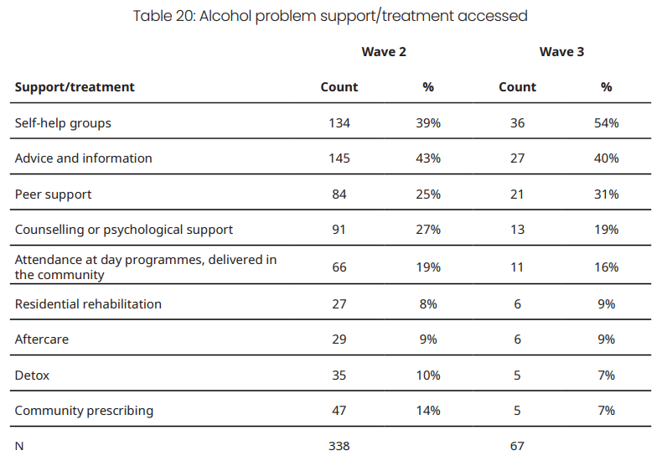
Substance use
Health management – barriers and consequences
Notes:
Can see here the support that people were accessing
TRENDS
Increase
self-help
peer support
Decrease
- Counselling or psych support

Slide 20
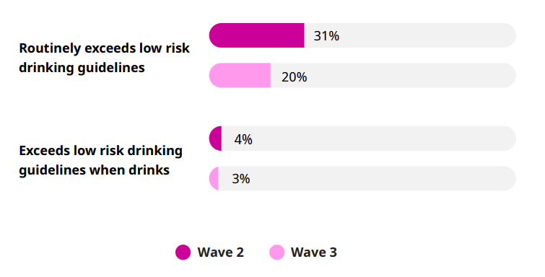
Alcohol
Key findings
Notes:
Picture is quite different with alcohol
We look at drinking against the Chief Medical Officer’s low risk drinking guidelines
TREND
- a decrease in drinking over these low risk guidelines
- HHNA respondent drinking levels are lower than the general population: (Alcohol change)
This picture was quite surprising. Need to learn more about why.
GEN POP (Alcohol Change)
England and Scotland
- 27% of people who drink alcohol binge-drink on their heaviest drinking days (HHNA 3%)
- 24% of adults regularly drink over the Chief Medical Officer’s low-risk guidelines (HHNA 20%)

Slide 21
Alcohol
Health management – barriers and consequences
29% of respondents report that they have, or are recovering from, an alcohol problem
32% of those wanted more support than they received to help them manage their alcohol use
  18% of respondents received some support/ treatment but felt that they needed more
  15% of respondents currently received no support/ treatment but felt that it would help them.
Notes:
When we asked people about the care that they received:

Slide 22


Do people get the help that they need?
Key findings
Across the board people want more help than they get to manage their health.
45% of those with a mental health condition
40% of those with a physical health condition
40% of those with a
substance use problem
32% of those with an alcohol problem
Notes:
Looking across the board..
Figures range between 32% and 45%
More so for mental health than any other area.
NEXT LOOK AT WELLBEING AND PREVENTATIVE HEALTHCARE

Slide 23
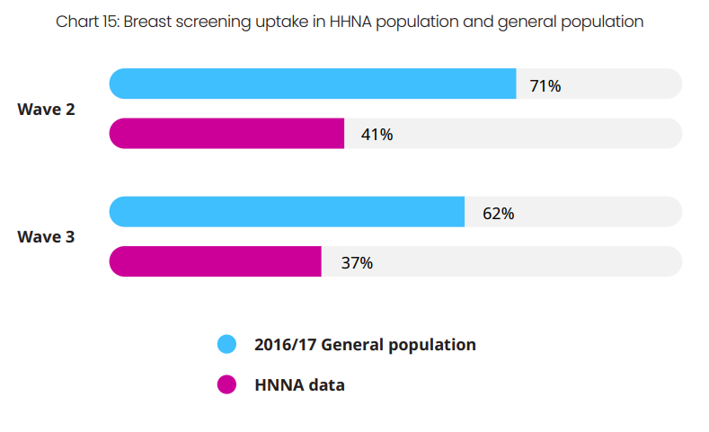
Wellbeing and preventative healthcare preventative screening
Notes:
HERE WE CAN SEE SCREENING DATA – BREAST SCREENING
Screening take up is lower amongst people experiencing homelessness
TREND:
Rate dropped between waves 2 and 3 – COVID-19?
Either way – remain lower than the Gen Pop
Similar trend in cervical screenings –
Wave 3
54% HHNA respondents had taken up a screening
70% general population
These screenings are really important in protecting women from the worst experiences of cancer

Slide 24

Wellbeing and preventative healthcare
Smoking
HHNA respondents
76% smoke cigarettes, cigars or a pipe
General population
13.8% of adults are either ‘occasional’ or ‘regular’ smokers.
Notes:
When we turn to look at smoking:
Smoking rates are much higher than the Gen Pop
TRENDS
Some variation, but similar across all waves
WAVE 2 - 79% (2015-2017)
WAVE 1 - 77% (2010-2014)
MOST RECENT DATA – GIVING UP
50% of this group in wave 3 wanted to give up
46% had not been offered support to give up smoking
40% of those who were offered support didn’t take it up
We need to understand more about the barriers to take up
NEXT: briefly look at wellbeing indicators
13.8% from 2022 National GP Patient Survey

Slide 25
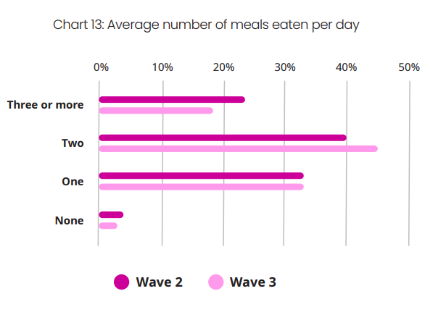
Wellbeing and preventative healthcare
Wellbeing
Notes:
When we look at wellbeing
Respondents also scored low on these indicators
MEALS A DAY:
one meal a day - (33%)
two meals a day = 45%
three or more meals per day - 18%
Similar picture on FRUIT AND VEG:
66% of respondents ate one or fewer portions of fruit or veg per day
Just 4% ate the recommended 5 or more portions of fruit or veg per day

Slide 26

Wellbeing and preventative healthcare
The upshot
People experiencing homelessness:
  Fare worse on basic wellbeing indicators than the general population
  Access preventative healthcare at lower rates than the wider population
This exacerbates health inequalities:
  levels of smoking and poor nutrition affect wider health
  lower take up of vaccinations and screenings increase the risk of illness and disease.
Notes:
The UPSHOT
So far we’ve seen a picture of increased poor health, high inequalities and reported insufficient support across the board.
Turn to look at how people are accessing healthcare services

Slide 27
Access to primary medical care
Key findings
97% of respondents were registered with a GP or specialist homeless healthcare service (92% in wave 2).
6% of respondents had been refused registration at a GP/ homeless healthcare service in the 12 months before responding to the survey.
Dental registration is much lower, at 53% (49% wave 2)
Notes:
START WITH SOME GOOD NEWS!
REFUSALS
Indicating that there are still some issues with GP reg
Reasons given: “no photo ID”, “no address” and “told I was out of the area”.
Everyone in the UK has the right to register with a GP, regardless of whether they have ID or an address; it should also usually be possible to register at a GP which is not near to your home.
Dental reg
This is particularly an issue given it is second most commonly reported physical health issue

Slide 28

Use of acute medical care
Key findings
 | A&E | Ambulance | Hospital admission
% used in the last year | 48% (50% wave 2) | 38% (37% wave 2) | 38% (38% wave 2)
Level of use | On average attended 3x more than gen pop | 8% used more than 3 times | 7% admitted over 3 times
% due to physical health problem/ condition | 32% | 38% | 37%
% due to mental health crises | 32% | 27% | 28%
Notes:
USE OF ACUTE MEDICAL CARE:
% of people using
Not much change over time
Higher users of emergency services than Gen Pop – 3x A&E
And 7-8% used an ambulance and were admitted to hospital more than 3 times in a year
We can see here that
Physical and mental health are key drivers.
Particularly want to highlight mental health crises as driver of emergency service use
We can assume there is a relationship between the proportion of people who want more support than they get AND high emergency service use.

Slide 29
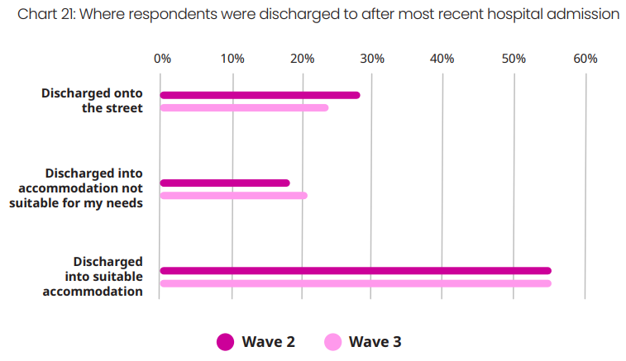
Hospital discharge
Key findings
Notes:
ON LAST HOSPITAL STAY
67% of people were asked if they had somewhere suitable to stay (72% W2; 70% W1)
THIS IS GREAT, BUT
Asking the question does not make sufficient appropriate accommodation available
More than 20% discharged into accommodation not suitable for their needs
24% discharged onto the street
THIS IS A separate and aligned systemic challenge - speaks to the importance of tackling health and homelessness together.
See the consequences of this in readmission rate:
26% readmitted within 30 days (22% W2)

Slide 30
How do health and homelessness interact?
Slightly more people are diagnosed with a physical health problem after they experience homelessness. 56% of wave 3 respondents received a diagnosis after becoming homeless
Of those reporting a mental health condition, 72% reported that this condition predated their experience of homelessness.
This suggests that mental ill health predates homelessness, and can then be further exacerbated by the experience of homelessness.
By contrast, our data suggests that physical health is slightly more likely to be a result of homelessness
Notes:
Early findings only
- Asked people for each mental/ physical health condition whether they started to experience it before/ after becoming homeless
WE FOUND THAT:
Building on existing evidence
Existing evidence suggests negative physical health impacts of homelessness i.e. Groundswell ‘Room to Breath’ respiratory
The long shot
lots of people are unwell when they become homeless.
Often we’re leaving (already unwell) people in circumstances known to worsen their health

Slide 31
So what's the big picture?
The health of people experiencing homelessness is worse across the board – but particularly mental health
There is a gap in every instance between the support that people feel that they need and the support that they are able to access. This is most stark for people with a mental health condition.
GP registration is high, but people who experience homelessness are still higher users of emergency healthcare services
Not getting the support that they need leads people to self-medicate – perpetuating a cycle of poor health and homelessness
Many people have health needs when they become homeless, especially around mental health.
Notes:
Worse than the general population
Worse than it was in USOH 2014
- MH – from 45% to 82%
GAP IN SUPPORT – around 32-45%
EMERGENCY SERVICES – 3X more A&E attendance
SELF-MED – 45%
HEALTH PREDATING HOMELESSNESS –
72% of mental health problems predated experience of homelessness
44% of physical health problems predated experience of homelessness
This overall picture seems to suggest that there are some universal barriers to accessing healthcare for people experiencing homelessness.

Slide 32
What next?
We need to do more to understand these barriers and unpick them.
Homelessness is a health issue.
Better understand the issues in your area – do a HHNA.
Notes:
This is really a question for you all!
Have taken some steps towards understanding homelessness as a health issue
Need to work closely locally with our ICBs to ensure that they understand and act on homelessness as a health issue
Locally we can better understand the issues in your area in order to make decisions that work for your population → do a HHNA
THANK YOU ALL FOR YOUR TIME ON THAT WHISTLESTOP TOUR OF OUR FINDINGS.
DO READ THE REPORT, THERE’S LOADS MORE IN THERE!

Slide 33
Homeless Health Needs Audit
For over a decade, organisations around the country have used the Homeless Health Needs Audit (HHNA) to help understand health inequalities faced by people experiencing homelessness in their area.
The HHNA is a tool for gathering local data about the physical and mental health needs of people experiencing homelessness and how they access services.
The HHNA toolkit gives you a framework you can use to bring together the right local partners and members of your areas Integrated Care System to plan and carry out the audit. It also gives guidance on using the data you gather to reduce health inequalities by informing service improvements and commissioning.
The HHNA is a proven approach that provides you with valuable local insights into the health and wellbeing of people experiencing homelessness.
What we do
Homeless Link is the national membership charity for frontline homelessness services. We work to improve services through research, guidance and learning, and campaign for policy change that will ensure everyone has a place to call home and the support they need to keep it.
homeless.org.uk
@HomelessLink

